Slide 1
Digital Image Watermarking and Extraction
Group 20

Slide 2
Group Members
Name | Enrollment No.
Hiya Shah | AU2340099
Kaushika Rathod | AU2340133
Krish Chaudhari | AU2340021
Vansh Popat | AU2340256
Yashvi Jakharia | AU2340100

Slide 3
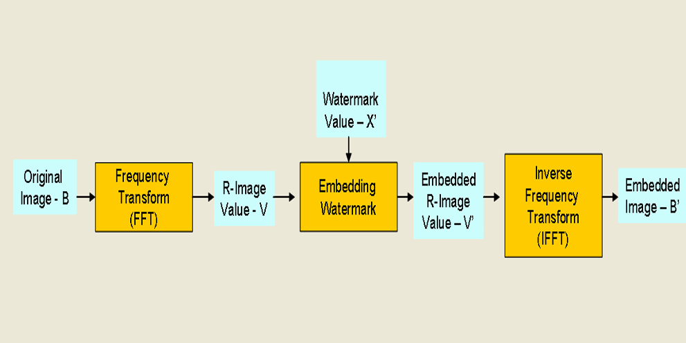
Before Mid-Sem
Explored various watermark embedding techniques
Finalized on DFT (Discrete Fourier Transform)
Results – Good, PSNR = 51.68 db
Methodology
Chen, B.; Wornell, G.W. Quantization index modulation: A class of provably good methods for digital watermarking and information embedding. IEEE Trans. Inf. Theory 2001, 47, 1423–1443.

Slide 4
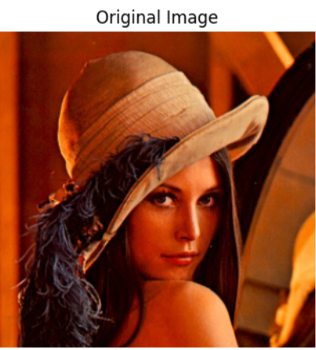
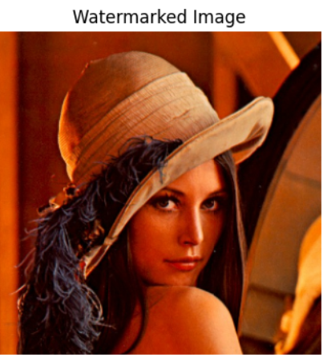
RESULTS
DFT Watermarking results:
PSNR: 51.68 dB
SSIM: 0.9981
After receiving the midsem feedback, we did not use the lena image

Slide 5
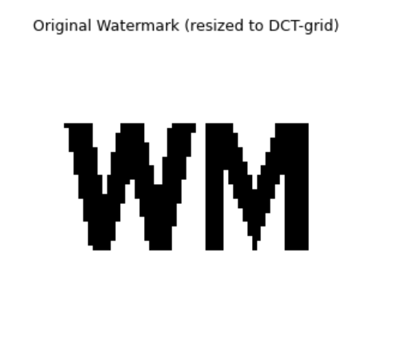
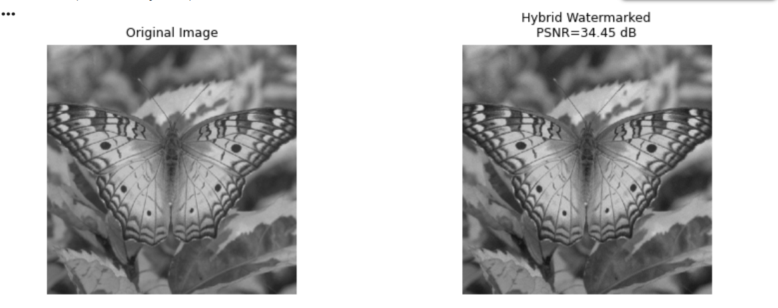
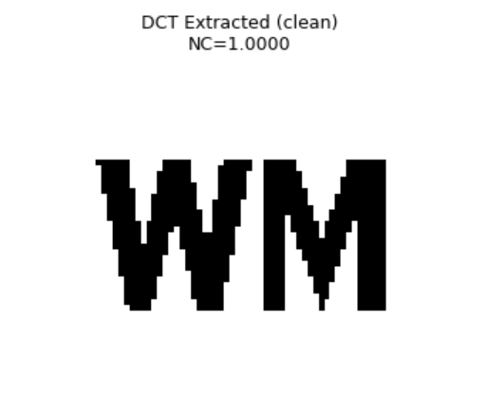
AFTER MID-SEM
Explored techniques for extraction
Tested them under different attacks and transformations
NC values not satisfying
Changed embedding algorithm to a hybrid DCT + DFT algorithm (PSNR = 34.45 db)
Extracted using DCT only

Slide 6
METHODOLOGY
Pre Processing
DCT-based Blind Watermark Embedding
DFT Magnitude Embedding
Hybrid Watermark Construction
Attack Simulation
ORB based registration
Blind DCT Watermark Extraction
Visualization

Slide 7
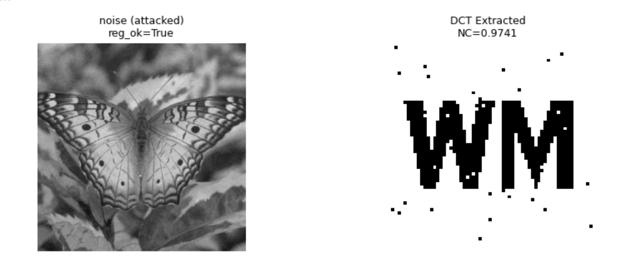
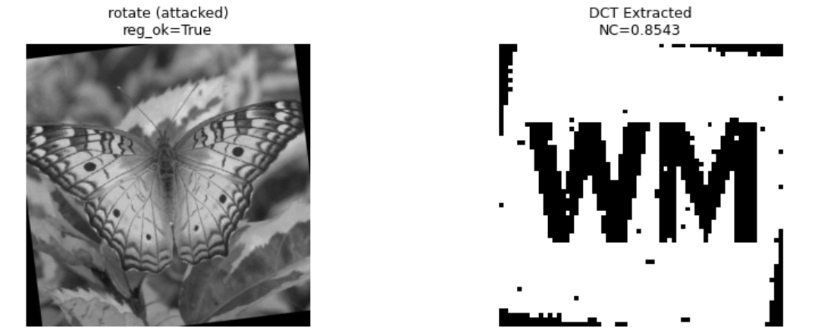
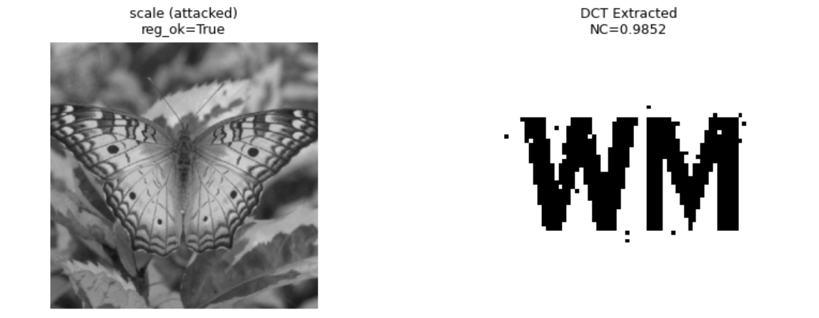
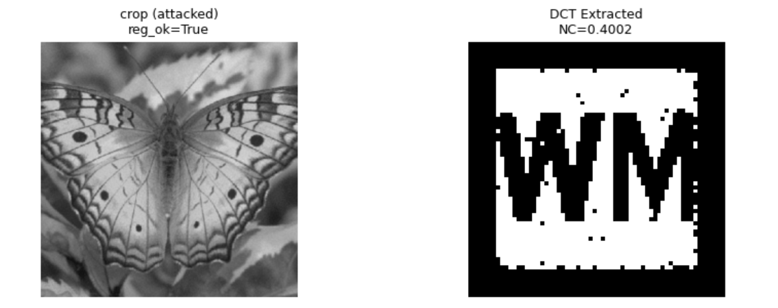
RESULTS UNDER ATTACKS

Slide 8
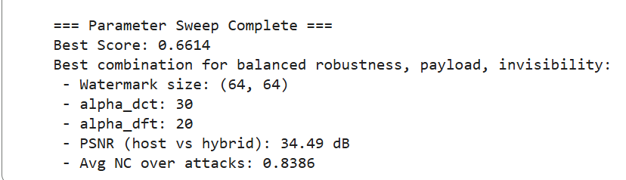
PARAMETER LIST

Slide 9
CONCLUSION
Successful Implementation of a Hybrid Watermarking Approach
High Imperceptibility of the Watermarked Image (PSNR ~ 28-40 db)
Reliable Blind Extraction Using Only DCT Layer
Strong Robustness Against Common Attacks (Verified by the NC values)
Visualization Supports Robustness Evaluation

Slide 10
REFERENCES
Cox, I.J., et al., Secure spread spectrum watermarking for multimedia. IEEE Trans. Image Processing, 1997. 6: p. 1673-1687.
Chen, B.; Wornell, G.W. Quantization index modulation: A class of provably good methods for digital watermarking and
information embedding. IEEE Trans. Inf. Theory 2001, 47, 1423–1443.
3. Pardhu, T.; Perli, B.R. Digital image watermarking in frequency domain. In Proceedings of the 2016 International Conference on
Communication and Signal Processing (ICCSP), Tamilnadu, India, 6–8 April 2016; pp. 0208–0211.
4. Darwish, S.M.; Al-Khafaji, L.D.S. Dual watermarking for color images: A new image copyright protection model based on the
fusion of successive and segmented watermarking. Multimed. Tools Appl. 2020, 79, 6503–6530.
5. Kang, X.; Chen, Y.; Zhao, F.; Lin, G. Multi-dimensional particle swarm optimization for robust blind image watermarking using
intertwining logistic map and hybrid domain. Soft Comput. 2020, 24, 10561–10584.
6. S. Boujerfaoui, R. Riad, H. Douzi, F. Ros, and R. Harba, “Image Watermarking between Conventional and Learning-Based Techniques: A Literature Review,” Electronics, vol. 12, no. 1, Art. no. 74, Jan. 2023.
7. C. M. Pun, “PDM: A Novel DFT-Based Digital Watermarking System for Images,” in Proc. 8th Int. Conf. on Signal Processing (ICSP), Beijing, China, 2006.

Slide 11
THANK YOU

